Slide 1


Slide 2
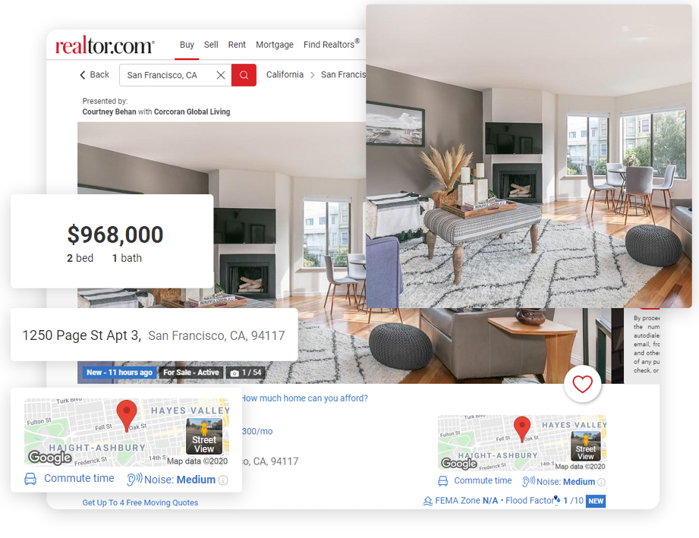
Real Estate
Web Scraping and EDA Project Presentation
Using
Python Package
– Beautiful Soup &
Regex

Slide 3
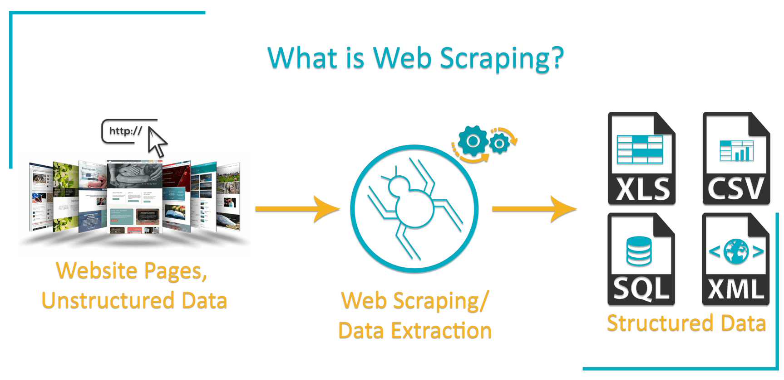
WHAT IS WEBSCRAPING ?
Web Scraping is a term used to describe the use of a program or algorithm to extract and process large amounts of data from the web.
In a simple words, web scraping refers to the extraction of data from a website. This information is collected and then exported into a format that is more useful for the user.
Web scraping is a highly effective method to extract data from websites (depending on the website’s regulations)

Slide 4
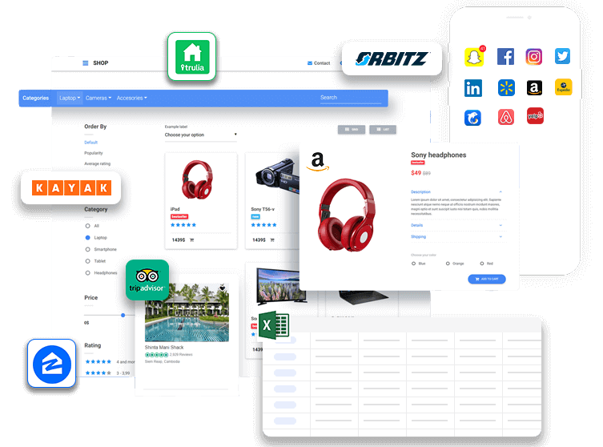



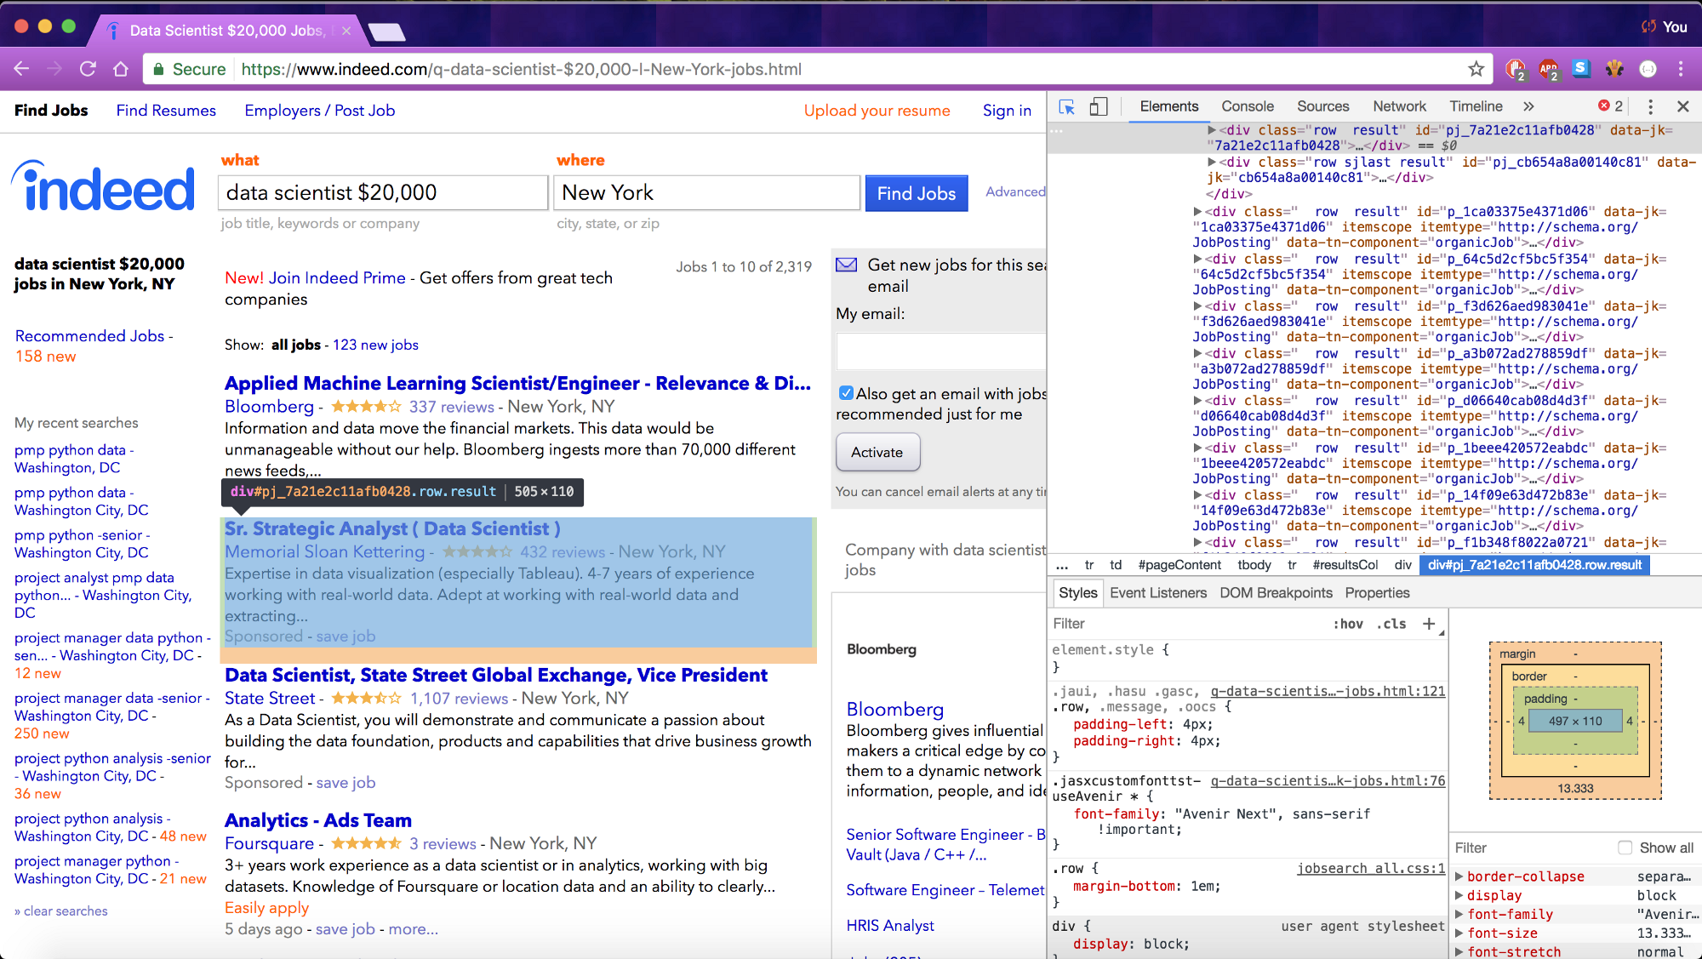
BUT WHY DOES SOMEONE HAVE TO COLLECT SUCH LARGE DATA FROM WEBSITES?
Price Comparison
Email Address Gathering
Social Media Scraping
Research and Development
Job listings:

Slide 5


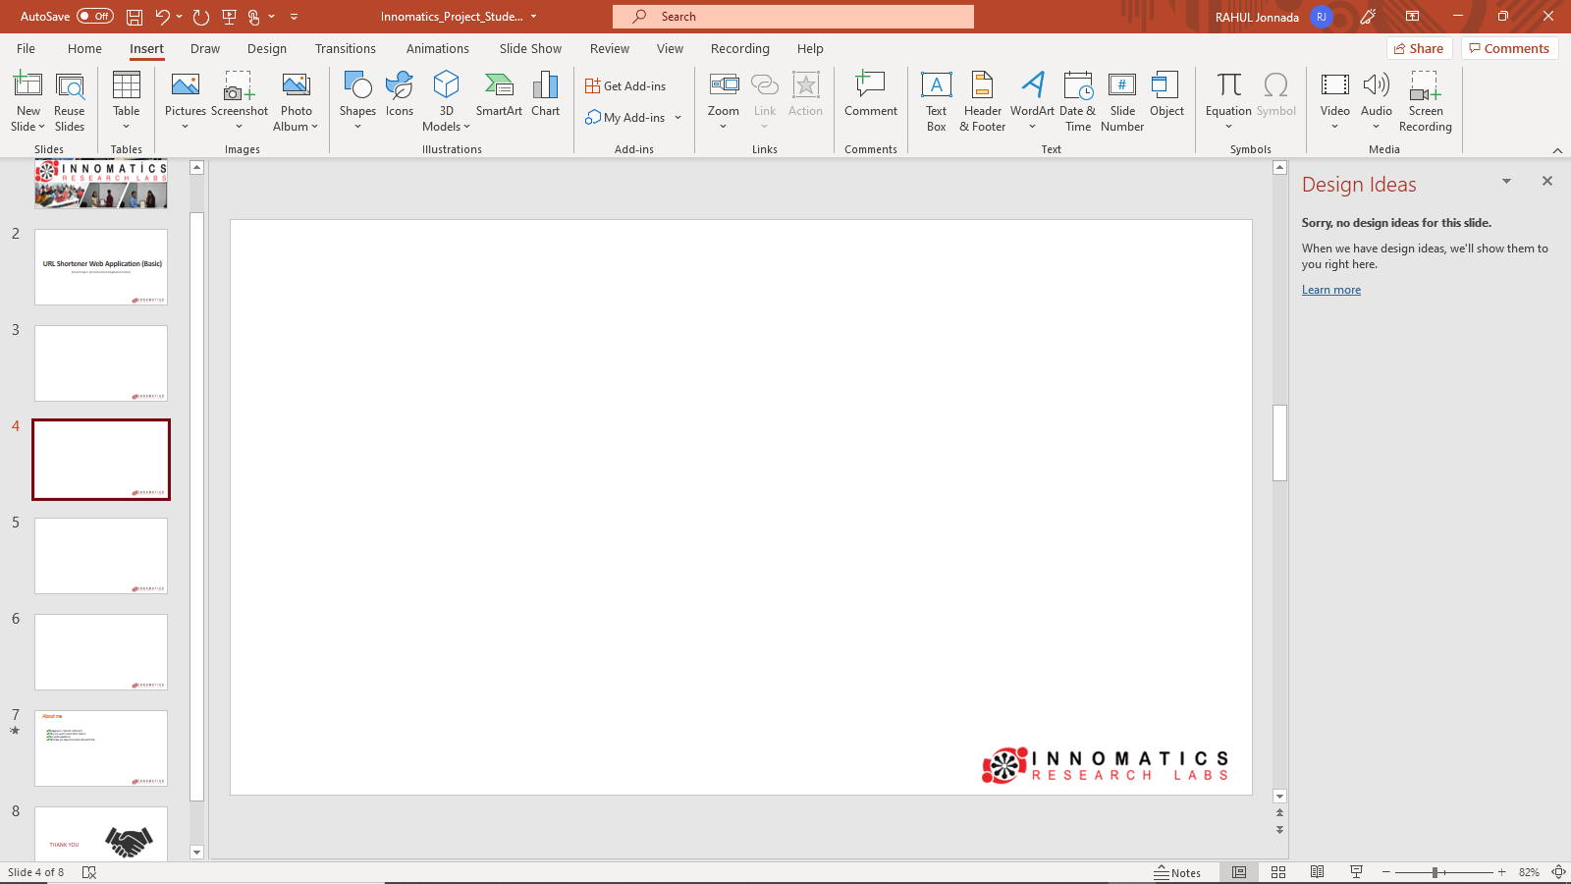
PROJECT
Downloading the Contents
Extracting the Data
Storing the Data
Analyzing the Data

Slide 6
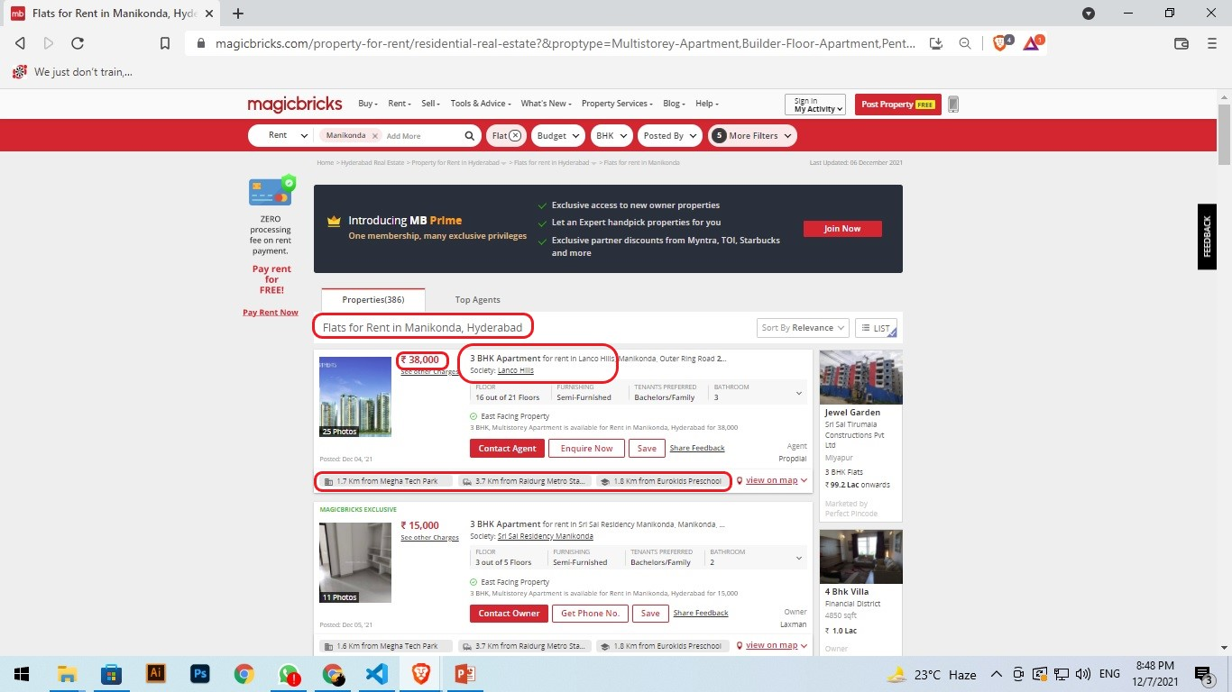
SCRAPING RENTAL PROPERTY DETAILS LIKE LOCALITY, PRICE, NEAR BY PLACES OF THE APARTMENT AND NUMBERE OF ROOMS FROM THE MAGICBRICKS WEBSITE:

Slide 7
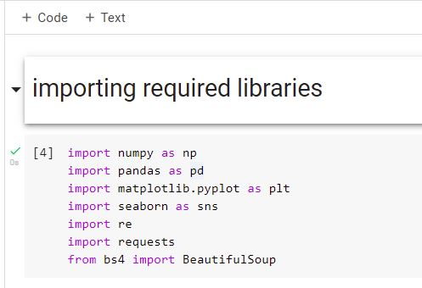
PYTHON LIBRARIES USED HERE FOR WEB SCRAPING
ABOUT
Most powerful numerical processing library in python. Array Oriented computing.
Pandas is a fast, powerful, flexible and easy to use open source data analysis and manipulation tool.
Matplotlib is a comprehensive library for creating static, animated, and interactive visualizations in Python
Seaborn is a Python data visualization library based on matplotlib. It provides a high-level interface for drawing attractive and informative statistical graphics.
A regular expression (or RE) specifies a set of strings that matches it.
The requests module allows you to send HTTP requests using Python. The HTTP request returns a Response Object with all the response data (content, encoding, status, etc).
Beautiful Soup is a Python library for getting data out of HTML, XML, and other markup languages

Slide 8
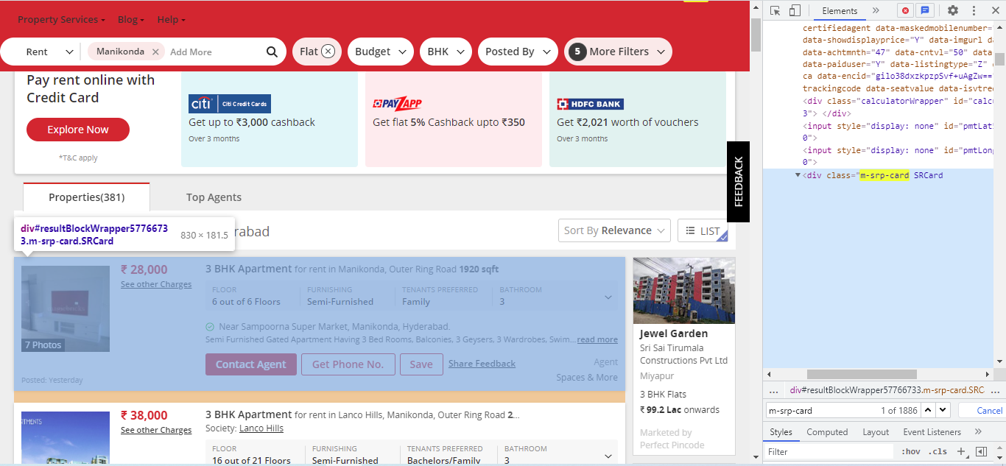
EXPLORING HTML CONTENT AND EXTRACTION

Slide 9
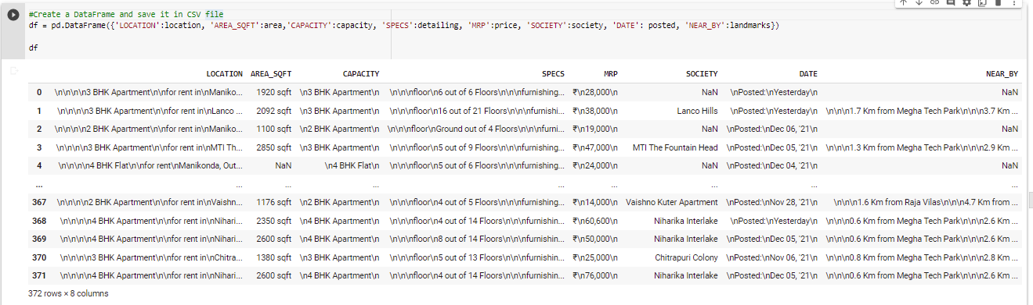
CREATE A DATAFRAME AND SAVE IT IN CSV FILE

Slide 10
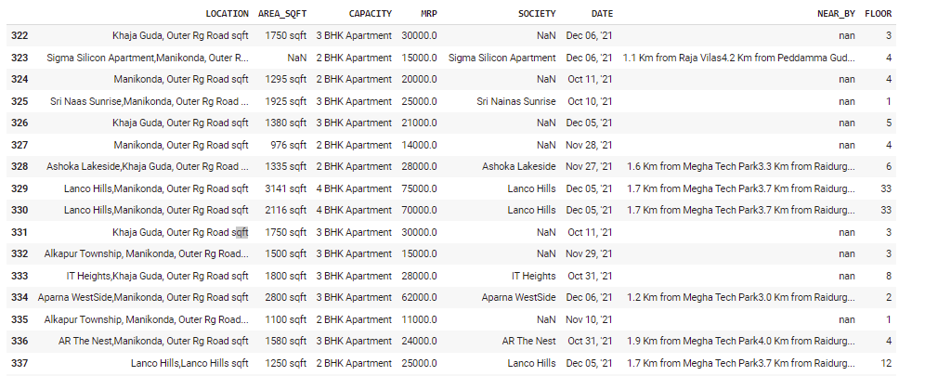
EDA

Slide 11

OUTPUT

Slide 12
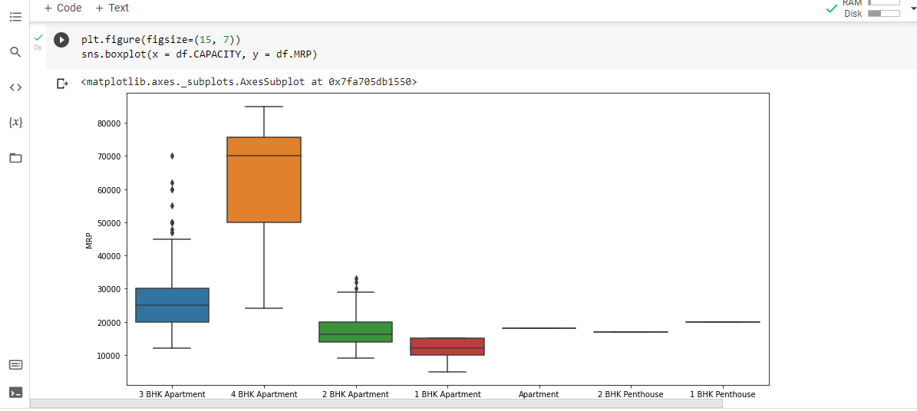
BOXPLOT

Slide 13
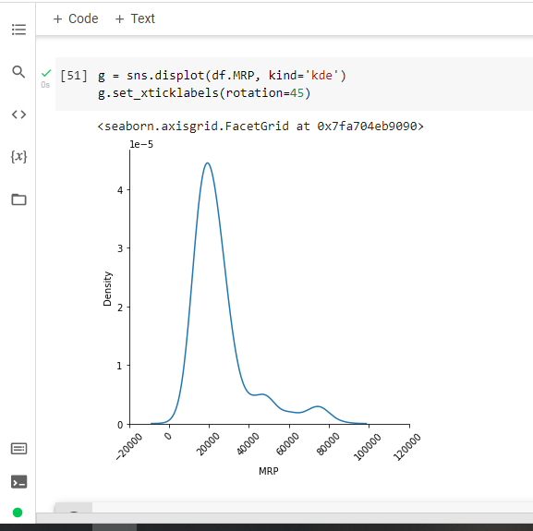
DISPLOT

Slide 14
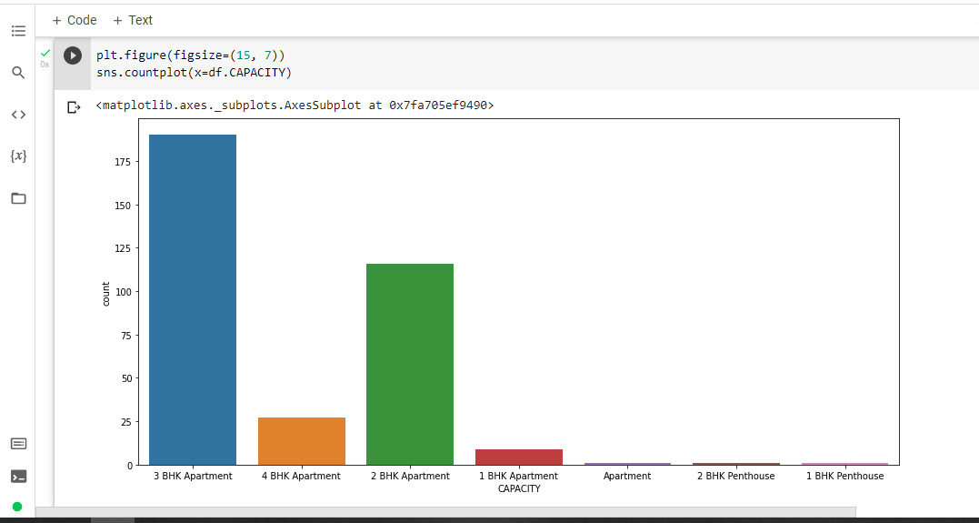
COUNTPLOT

Slide 15
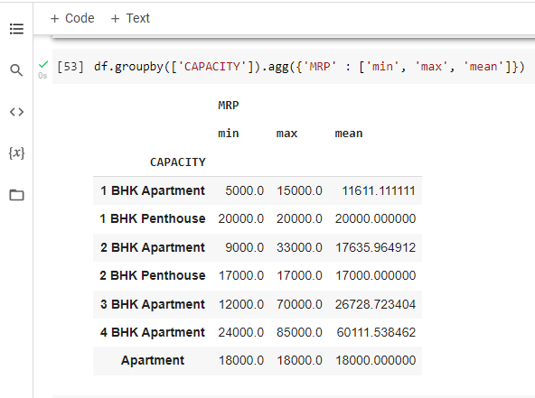
MEAN/AVARAGE PRICE

Slide 16
CONCLUSION - The above plots show us the count for type Apartment. We can see that 3 BHK is having highest number of product listing on MAGICBRICK website.

Slide 17

ANY QUESTION?

Slide 18

THANK YOU

